Slide 1
GP Spring Education & Networking Evening
9th May 2022

Slide 2
Welcome & Panel Introductions
Dr Richard Horgan, Consultant Obstetrician & Gynaecologist at CUMH, co-chair of CUMH/GP liaison committee
Ms. Majella Phelan, CMM2, Smoking Cessation
Ms. Alex Campbell, Registered Advanced Midwife Practitioner
Dr Fergus McCarthy, Consultant Obstetrician & Gynaecologist
Dr Mairead O’ Riordan, Consultant Obstetrician & Gynaecologist

Slide 3

Smoke Free Start CUMH – Right Care, Right Place, Right Time
Majella Phelan, CMM2, Stop Smoking

Slide 4

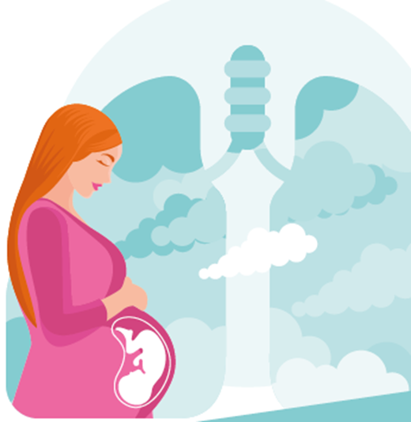



Smoke Free Start
Onsite, midwifery-led stop smoking service.
Introduced opt-out stop smoking service in CUMH.
Introduced Breath Carbon Monoxide (BCO) testing for all pregnant women.
Provide intensive Standard Treatment Programme for smoking cessation.
Introduce Making Every Contact Count programme to CUMH.

Slide 5


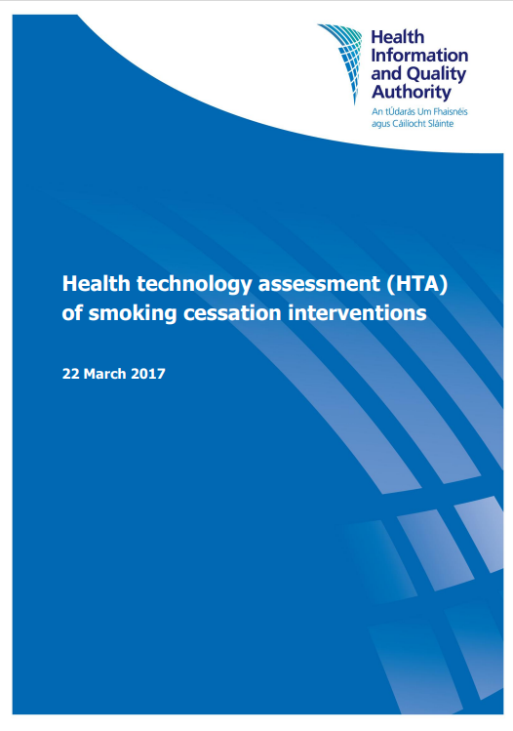
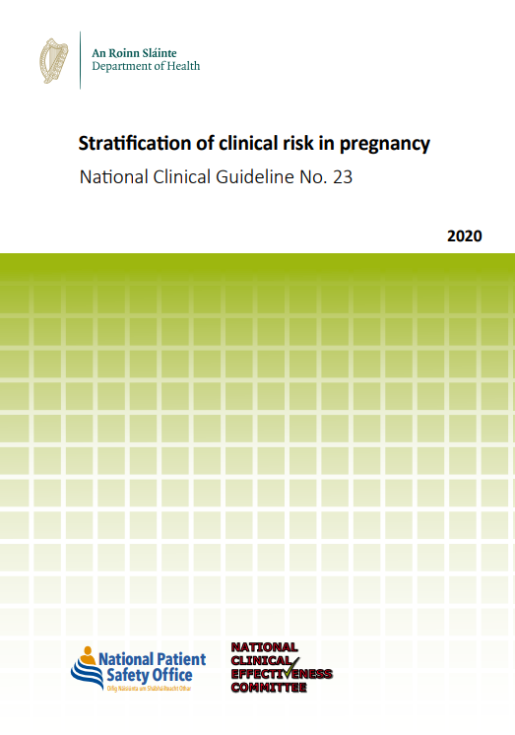




Smoking in Pregnancy Guidelines

Slide 6
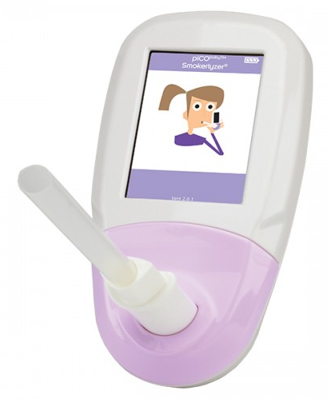
Breath Carbon Monoxide Testing (BCO)
Valid, reliable test to detect CO in exhaled air
Quick, safe, immediate result at POC
Non-invasive
BCO testing during antenatal care combined with ‘opt out’ referral to cessation services can increase attendance to support services by twofold and increases the probability of quitting by delivery by twofold (Campbell et al, 2016 and Bell et al, 2018)

Slide 7
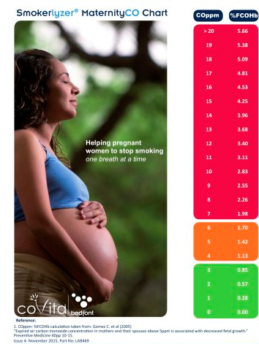
BCO TESTING IN MATERNITY
Prevents discrimination of the pregnant smoker
Identifies smokers who do not disclose their smoking habit
Identifies women exposed to second-hand smoke
Identifies women exposed to CO through faulty equipment
OPT OUT REFERRAL
Refer all women who currently smoke
All women who have recently stopped smoking for relapse prevention
Women who have a BCO higher than 4ppm
Any pregnant women who need support to stay quit

Slide 8
Standard Treatment Programme
Session 1 – Pre-quit assessment
Session 2 – Quit Date as soon as possible
Session 3 – 1 week post Quit Date
Session 4 – 2 weeks post Quit Date
Session 5 – 3 weeks post Quit Date
Session 6 – 4 weeks post Quit Date
There is also 12 week, 26 week and a 52 week post quit date follow up
Provided face-to face, telephone, online or a blended service.

Slide 9
Women Referred to Smoke Free Start
Total referrals - 1608
Smoke Free Babies – 472
Multiparous – 65%
Primiparous - 27%
Nulliparous - 8%

Slide 10

Smoking in Pregnancy in women attending CUMH
Up to 16% of women at booking have smoked at some stage of the current pregnancy.
Up to 33% of women at booking have a history of smoking.
Attending specialist care – 45%
Mental Health issues – 46%
Linked with social workers – 14%
Other addictions – 4.7%
ER/Inpatient – 64%

Slide 11
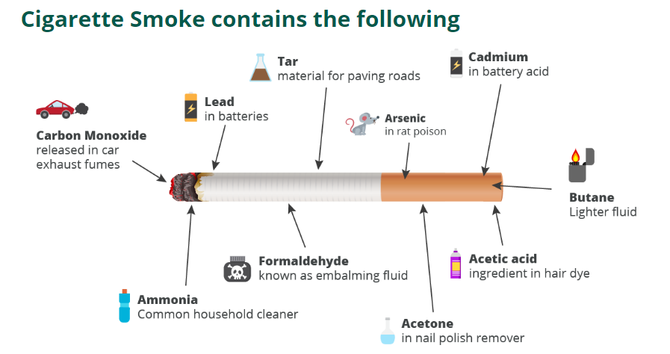

Slide 12
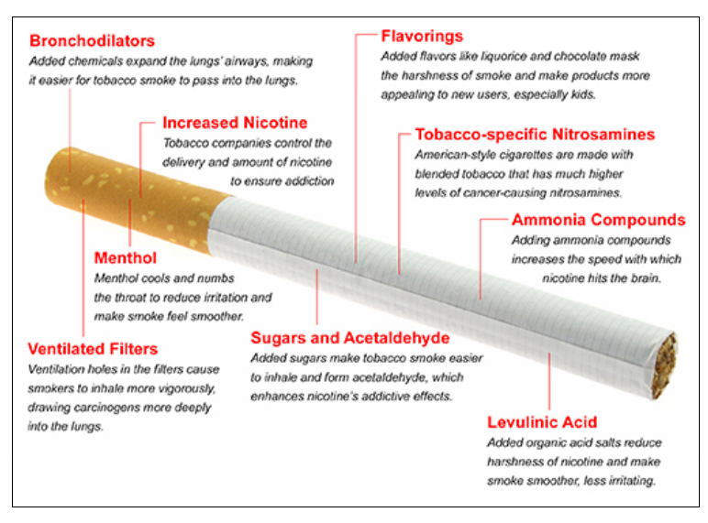
Cigarettes are Engineered to be Addictive
Bullets points in Helvetica font
Bullets points in Helvetica font
Bullets points in Helvetica font
Note logos at end of page can change

Slide 13






What women attending CUMH smoke

Slide 14
Consequences of smoking in pregnancy
Subfertility
Ectopic pregnancy (>1.7 times more likely)
Miscarriage (24%-32% more likely)
Preterm births (27 times more likely)
Placental problems
  Low-lying placenta (>1.5 times more likely)
  Placental abruption
IUGR
Stillbirth doubles the likelihood
  Highly associated with IUGR
Neonatal death (>1.7 times more likely)
Sudden Infant Death Syndrome (2-3 times more likely)
Reference: Action on Smoking and Health. The Smoking in Pregnancy Challenge Group: Review of the Challenge. July 2018)
Euro-Peristat Project. European Perinatal Health Report. Core Indicators of the health and care of pregnant women and babies in Europe 2015

Slide 15



LIFELONG IMPLICATIONS FOR THE CHILD
Attention deficit disorders, hyperactivity
Learning disabilities
Transplacental carcinogenesis
Hearth defects (50% more likely in smokers, increased risk in SHS)
Childhood obesity, Diabetes
Cleft lip

Slide 16
Women receiving care in CUMH who smoke
Pregnancy loss experienced by 36% of referrals, of these 37% had recurrent pregnancy loss.
IUGE/LBW/VLBW - 22%
VLBW – 3.5%
Birth weight < 3000g – 38%
Normal weight babies -14% GDM
Preterm births – 13%
PPROM – 3.5%
Placental problems – 5.4%
PPH – 19.5%
Fetal death in current pregnancy – 2.75%

Slide 17
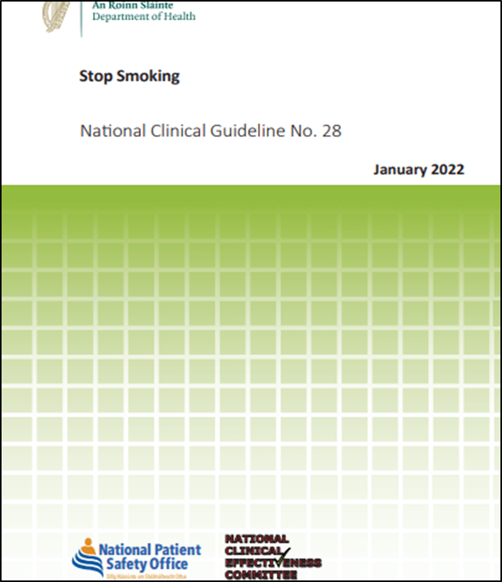
National Clinical Guidelines – Stop Smoking, No. 28
Prioritises pregnant women
Ask – and record smoking status
Is the client a smoker, ex-smoker or a non-smoker?
Are they exposed to second hand smoke in the car or
home?
Advise – on the best way of quitting
The best way to stop smoking is with specialist support, unsupported attempts are less effective.
Act – on woman’s response
Build confidence, give information, refer, prescribe.
Up to four times more likely to quit successfully with support.

Slide 18

Why specialist Maternity Stop Smoking Service
Recommended by National Maternity Strategy, HIQA HTA, National Clinical Guideline No 28, Stop Smoking
On site, can combine care with antenatal appointments
Provided by a Midwife with specialist training in behavioural change for pregnant women who smoke.
Service can liaise with other specialist services to give a multidisciplinary approach to antenatal care.
Provides a safer care pathway for women attending maternity services

Slide 19

Referring to Smoke Free Start
Email – Majella.Phelan@hse.ie
    Please put GP Smoking Cessation referral in email subject.
Letter – Majella Phelan CMM2, Smoking cessation service, Cork University Maternity Hospital.
Phone – 0871514202
Contact details on CUMH website

Slide 20




Slide 21
Introduction of the New Antenatal Care Pathways
Alex Campbell,
Registered Advanced Midwife Practitioner, Supported Care
9th May 2023

Slide 22
Why Change Antenatal Care Pathways?
To promote:
Streamlined person-centred visits during antenatal period.
Triage at pre-booking to assess risk occurs ahead of in-person appointment with Midwife and Obstetric Consultant.
Standardise antenatal care & information provided
GP visits to compliment hospital/community appointments.
Increase midwifery led clinics in the community, in line with National Maternity Strategy
Continuity of care meet midwife at every routine visit
Antenatal and health education at every midwife appointment

Slide 23
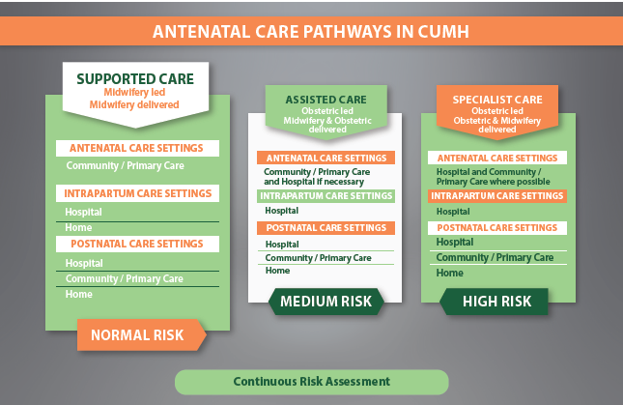
Antenatal Care Pathways
The National Maternity Strategy “Creating a Better Future Together” (2016) views childbirth as a natural life event however it also recognises that some women have higher care needs. Accordingly, the Strategy has designed one model of care with three care pathways for women progressing through the maternity system, depending on their level of risk:

Slide 24
Supported Care Pathway
The woman is respected as the primary decision maker and midwives assist her in this process through the provision of accurate and unbiased information on which to base informed choices.
Recognising the benefits of community-based continuity of care, the Supported Care Pathway aims to provide women with holistic, safe midwifery care.
Where deviations from the norm are suspected or identified, a multi-disciplinary approach to care will be adapted in collaboration with the woman.
At each antenatal appointment, the health and well-being of the mother and baby will be assessed – any confirmed or suspected concerns are referred as appropriate.

Slide 25
Outreach Locations
Area | Health Centre | Day | Times
Carrigtwohill | Carrigtwohill Primary Care Centre T45 DT93 | Mondays | All day
Carrigaline | Carrigaline Primary Care Centre P43 PX99 | Tuesdays | All day
Gurranabraher | St Mary’s Primary Care Centre T23 V09X | Wednesday, Fridays | All day
Mitchelstown | Living Health Clinic Primary Care Centre, Fermoy Rd., Mitchelstown, Co. Cork. | Wednesday | 8am – 2pm
Mallow | Mallow Primary Care Centre, Gouldshill, Mallow, Co. Cork | Thursdays | 8am – 2pm
*Ballincollig & Bantry have recently been confirmed as outreach locations. Clinics to commence soon
Women considered normal-risk can avail of
midwifery led antenatal care through the
Supported Care Pathway. Benefits include:
Easily accessible clinics
Free parking
Continuity of care
Scan clinics
The midwifery led clinics are set in
a relaxing, comfortable environment
around Cork city and county.
Regardless of the clinic location, care
will be provided by CUMH staff, and
babies will be born in Cork University
Maternity Hospital.

Slide 26
Antenatal Care Pathways
Notes:
Mention patient choice

Slide 27

Thank You

Slide 28
Triaging and E-referrals
Dr Fergus McCarthy,
Consultant Obstetrician Gynaecologist
9th May 2023

Slide 30
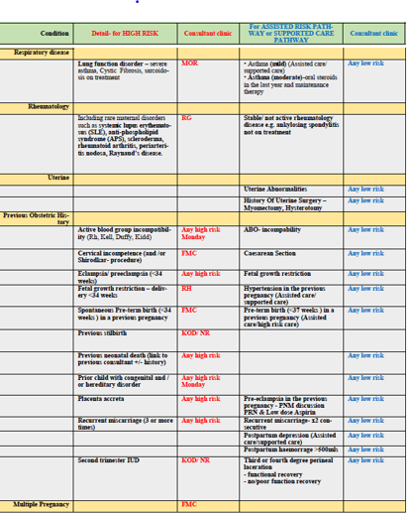
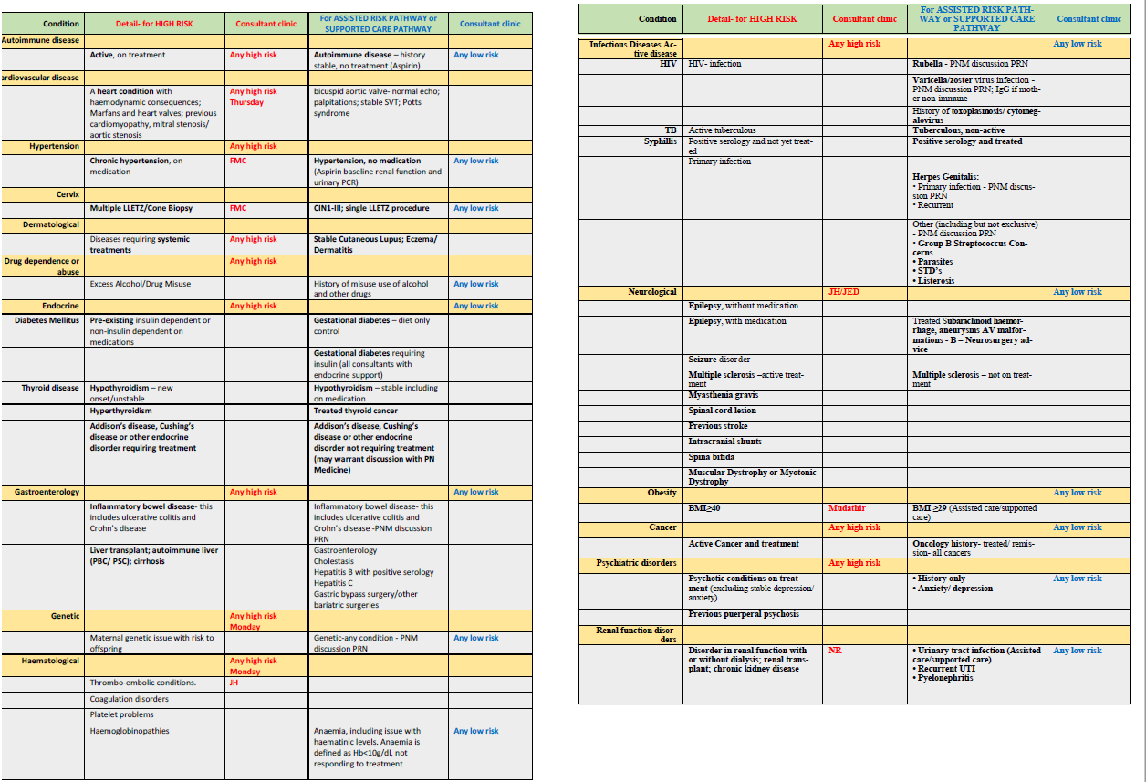
High-Risk Criteria
13
Notes:
Mention e-referral letter

Slide 31
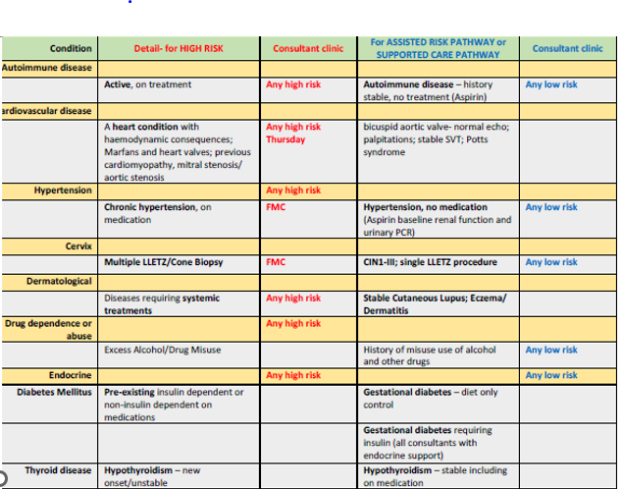
High-Risk Criteria
13
Notes:
Mention e-referral letter

Slide 32
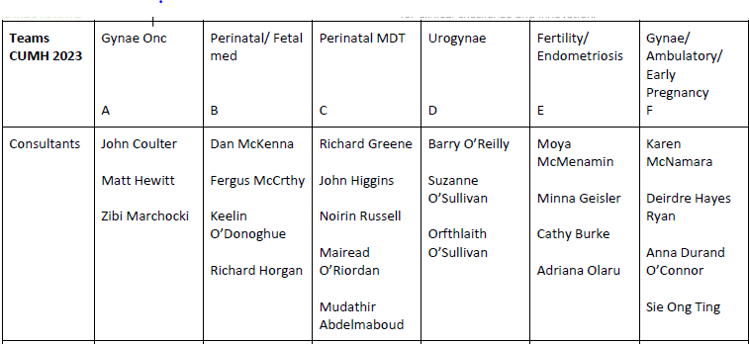
Specialist Teams
7

Slide 33
Membership MDT Antenatal Working Group
Midwifery management
OPD midwifery management
Project manager
Consultant rep
NCHD rep
Advanced midwife practitioner
Domino services
Early transfer home
Postnatal Hubs rep
Ultrasound
Clerical rep
Cerner CME
Communications manager
GP liaison
7

Slide 34

Antenatal Referral - Healthlink
E-referrals for antenatal patients (“new bookers”) into Cork University Maternity Hospital (CUMH) will be available via Healthlink from the week commencing 15th May 2023.
7

Slide 35
Thank you

Slide 36
Hot Topics in Antenatal Care
Dr Mairead O Riordan
Consultant Obstetrician & Gynaecology
09/05/2023

Slide 37

Vitamin D
Normal values
At risk groups
Supplementation Vs treatment
Pregnancy specific outcomes
Fetal /infant outcomes

Slide 38
Vitamin B12
Normal Values
At risk groups
Supplementation Vs treatment
  Boots and Tesco 2.5Ug Pregnacare 6ug
  Hydroxocobalmin Injections
Pregnancy specific outcomes
Fetal /infant outcomes
Notes:
WHO, US IOM , Australia Estimated average requirement (EAR) of vitamin B12 is 2.0 mcg daily and the intake recommended by the World Health Organisation, the United States’ Institute of Medicine and Australia’s National Health & Medical Research Council is 2.4 mcg per day for healthy adults, increasing to 2.6 and 2.8 mcg daily during pregnancy and lactation, respectively, based on the absence of megaloblastic anemia and the presence of normal serum vitamin B12 [6,7,8].
In the United Kingdom the Reference Nutrient Intake (RNI) is 1.5 mcg daily for adults, with an additional 0.5 mcg during lactation, based on the absence of anemia [9]. However, the usefulness of these markers of adequacy to determine these recommendations used has been questioned [10,11,12].
In contrast, the European Food Safety Authority recommendations are based on normalisation of all four biochemical markers of vitamin B12 status, setting an Adequate Intake of vitamin B12 of 4 mcg per day for adults, increasing to 4.5 mcg during pregnancy and 5.0 mcg for lactating women [13].
There is no upper limit set for intake of vitamin B12 [6,7,8,14,15] and intakes of 2000 mcg per day have been used for four months to treat deficiency without adverse effects reported [16].
Analysis of National Health and Nutrition Examination Survey (NHANES) data (n = 24,262) found that high supplemental vitamin B12 intakes were not associated with higher all-cause mortality [17].

Slide 39
Hypertension
Continue treatment unless
  Sustained systolic blood pressure is less than 110 mmHg or
  Sustained diastolic blood pressure is less than 70 mmHg or •
  Symptomatic hypotension. [2019]
Offer antihypertensive treatment
  Sustained systolic blood pressure of 140 mmHg or higher or
  Sustained diastolic blood pressure of 90 mmHg or higher. [2019]
When using medicines to treat hypertension in pregnancy, aim for a target blood pressure of 135/85 mmHg. [2019]
Nice Guidelines

Slide 40
Resources
https://www.nice.org.uk/guidance/ng133/resources/chronic-hypertension-prepregnancy-advice-pdf-8720711392
https://www.nice.org.uk/guidance/ng133/resources/planning-care-for-women-at-moderate-and-high-risk-of-preeclampsia-pdf-8720711390

Slide 41
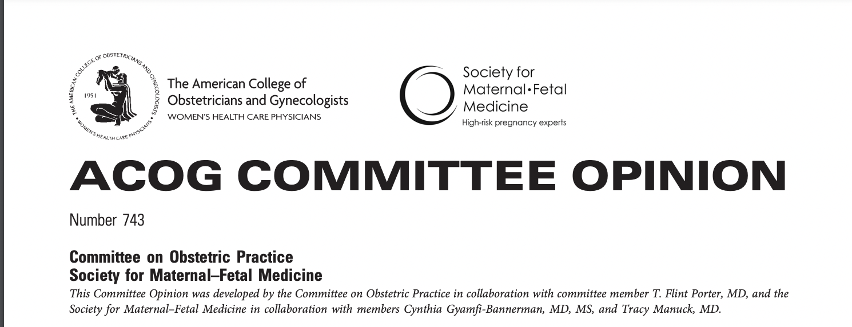
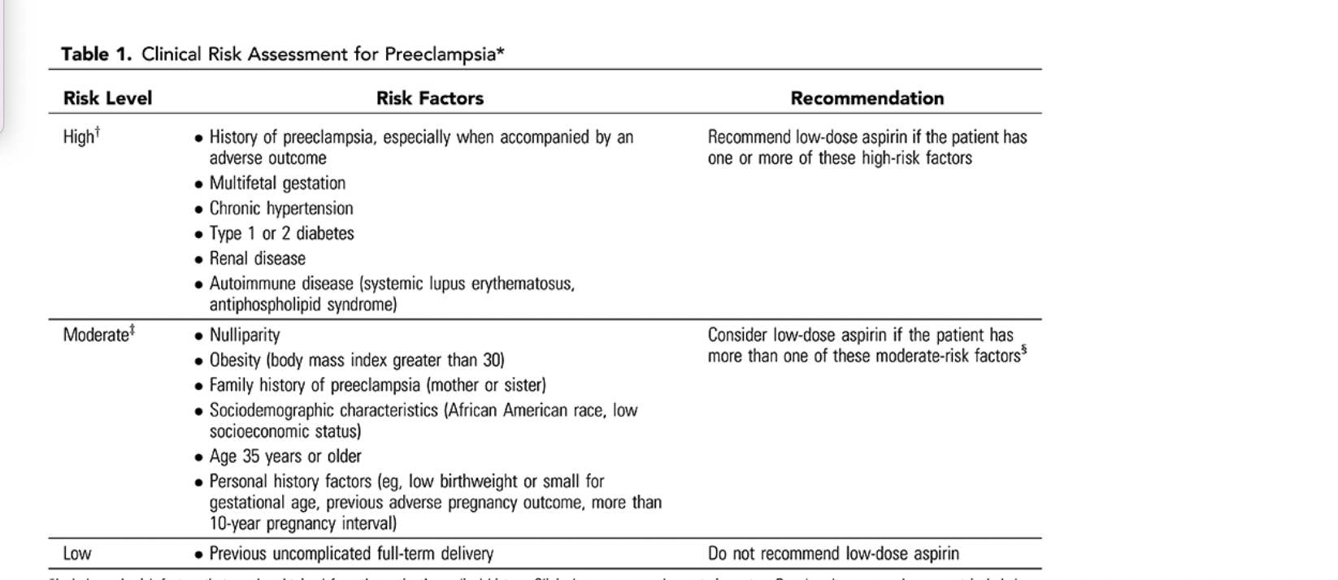
Hypertension

Slide 42
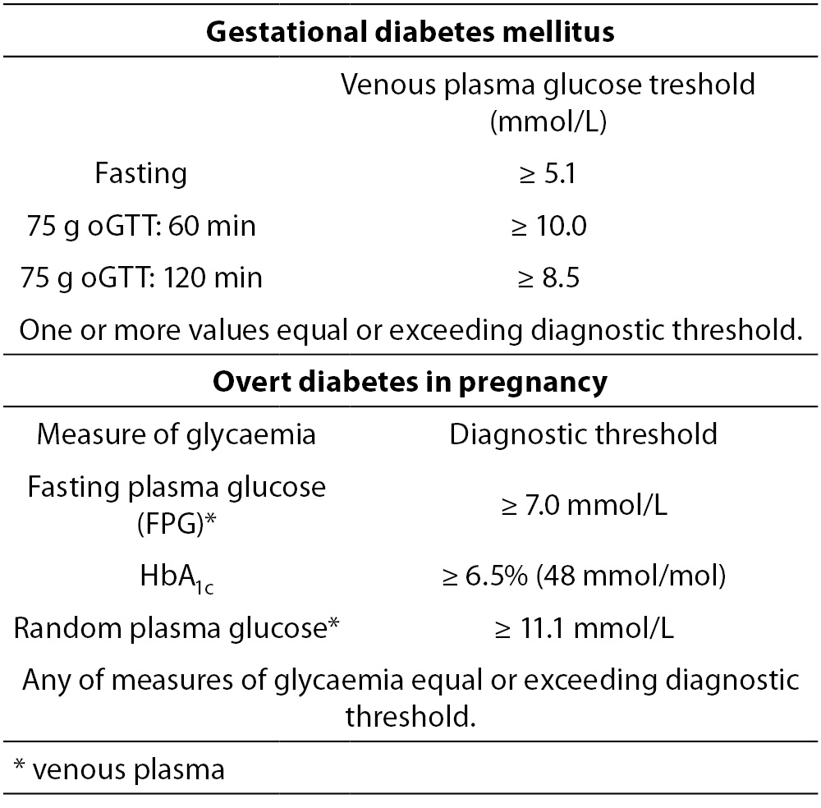
Gestational Diabetes

Slide 43
Long-term Progression
Cohort 1 (1978-1985)
  6 years 18% DM (4%Type 1 /14% Type 2)
  19 years, 37% DM (5% type 1 diabetes, 32% type 2 diabetes),29% had prediabetes, meaning only a third had normal glucose tolerance.
Cohort 2 (1987 and 1996.)
  7 years 41% had diabetes (4% type 1 diabetes, 37% type 2 diabetes) and 26% had prediabetes [9].
Risk of progression is 3-fold
Damm, P., Houshmand-Oeregaard, A., Kelstrup, L. et al. Gestational diabetes mellitus and long-term consequences for mother and offspring: a view from Denmark. Diabetologia 59, 1396–1399 (2016). https://doi.org/10.1007/s00125-016-3985-5

Slide 44
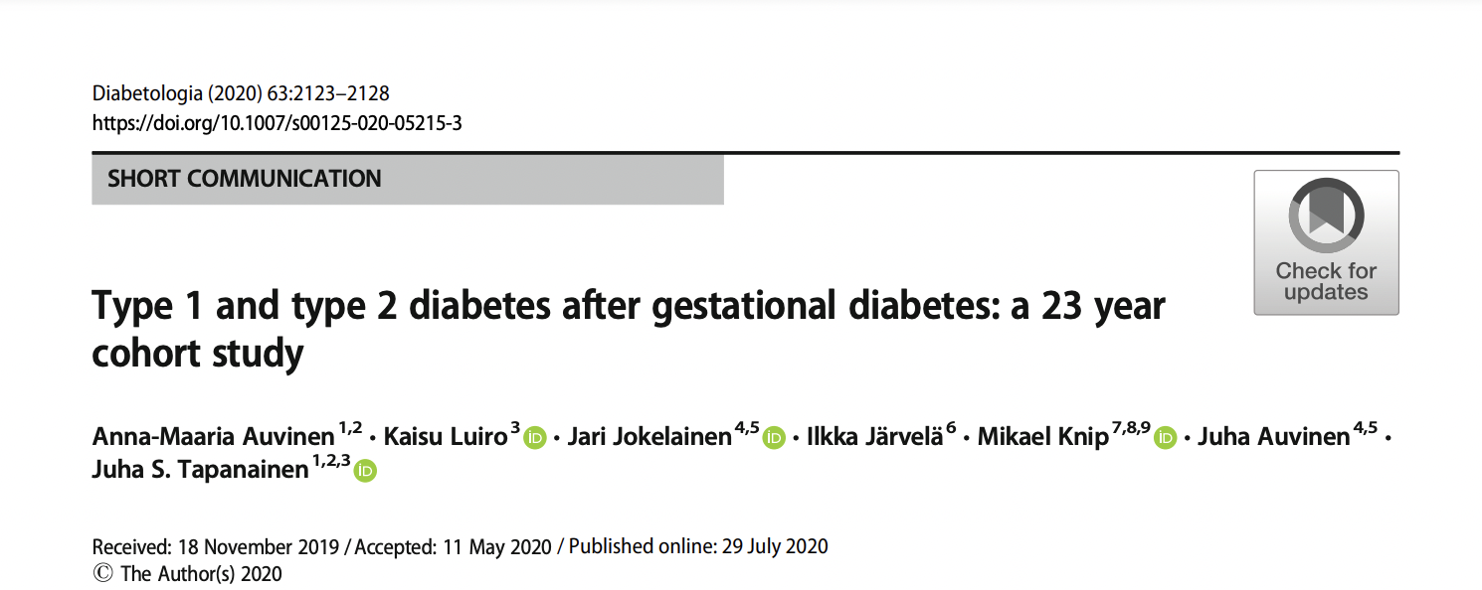
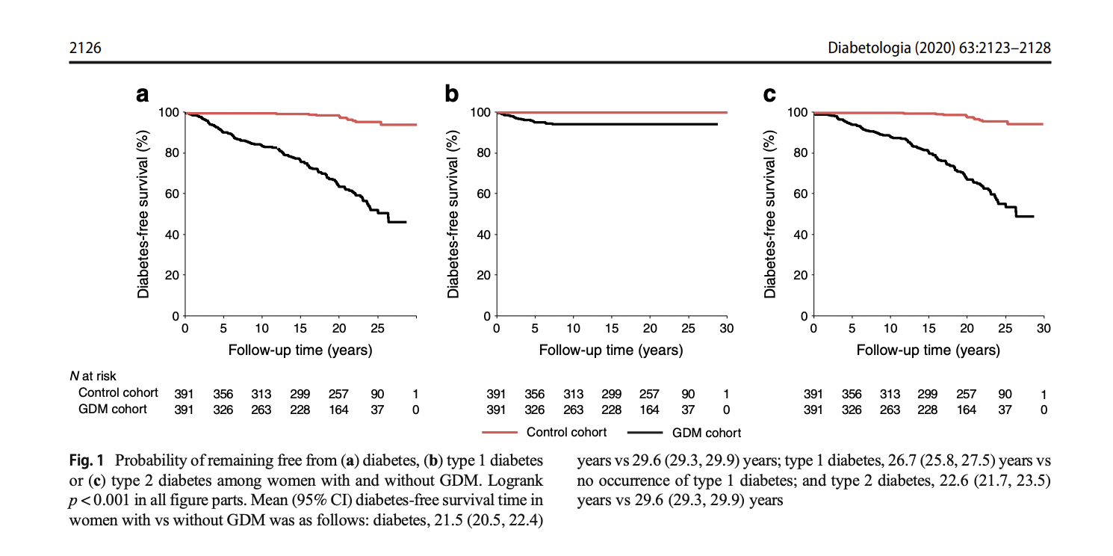

Slide 45
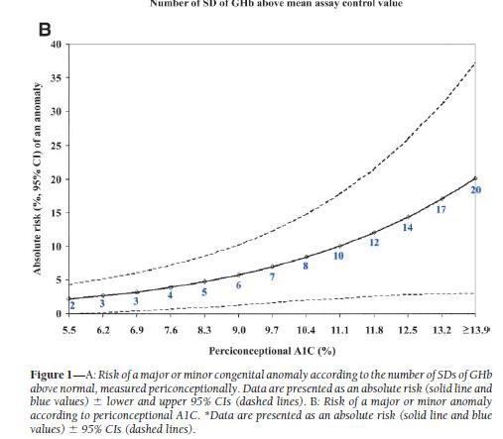
Risk of Congenital Abnormalities
Guerin A, Nisenbaum R, Ray JG. Use of maternal GHb concentration to estimate the risk of congenital anomalies in the offspring of women with prepregnancydiabetes. Diabetes Care. 2007 Jul;30(7):1920-5.

Slide 46
Thank You

