Slide 1
CUMH Integrated Midwifery- Led Services
Ms. Katie Bourke, Director of Midwifery/ Gillian Walsh, Senior Midwife
Cork University Maternity Hospital
12th February 2024

Slide 2
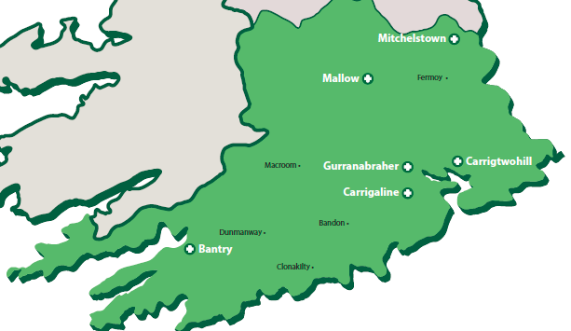
Services Provision for Integrated Care CUMH
DOMINO- Commenced 2007
Coís Tí Clinics- Commenced 2007
Early Transfer Home- Commenced 2020
Postnatal HUBS- Commenced Dec 2022
Homebirth- Governance Transfer Dec 2022

Slide 3
Midwifery-Led Activity in Community Locations CUMH
DOMINO STATS | 2023
BIRTHS | 179
SVD | 72.6%
INSTRUMENT | 17%
C/S RATE | 10% ↓
BREASTFEEDING | 94.5% ↑
INDUCTION | 23% ↓
EPIDURAL | 23%
P/N VISITS | 445
Homebirth | 2023
Total booked | 100
HOMEBIRTH | 37
HOSPITAL BIRTH | 34
T/F TO HOSPITAL | 36
AN T/F | 20
IP T/F | 14
P/N T/F | 2
INFANT TO NNU | 0
PPH | 2
BBA | 1
ETH | 2023
Visits | 274
Health HUB | 2023
Visits | 114

Slide 4
CUMH Clinic Locations
Area | Health Centre | 2023 Attendances | Clinic Type | Day | Time
Bantry | Bantry General Hospital | 198 | AN | Friday | 8am – 2pm
Ballincollig | Ballincollig PCC | 98 | AN, BF | Thursday | All day
Carrigtwohill | Carrigtwohill PCC | 809 | AN | Monday | All day
Carrigaline | Carrigaline PCC | 802 | AN | Tuesday | All day
Gurranabraher | St Mary’s PCC | 1000 | AN, PN,BR,DOMINO | Everyday | 8am – 4pm
Mitchelstown | Living Health Clinic PCC | TBC | AN | Wednesday | 8am – 2pm
Mallow | Mallow PCC | 828 | AN | Thursday | 8am – 2pm
Leap (New) | Leap PPC | TBC | BR, BF | Tuesday | All Day
*AN- Antenatal
*PN- Postnatal HUB
*BF- Breast Feeding Support Class
*BR- Birth Reflections
*DOMINO-Domicillary In & Out of Hospital

Slide 5
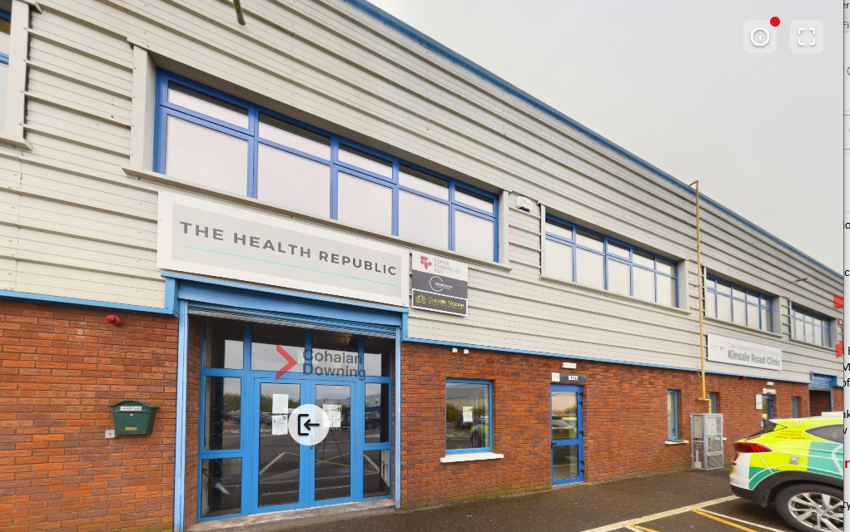
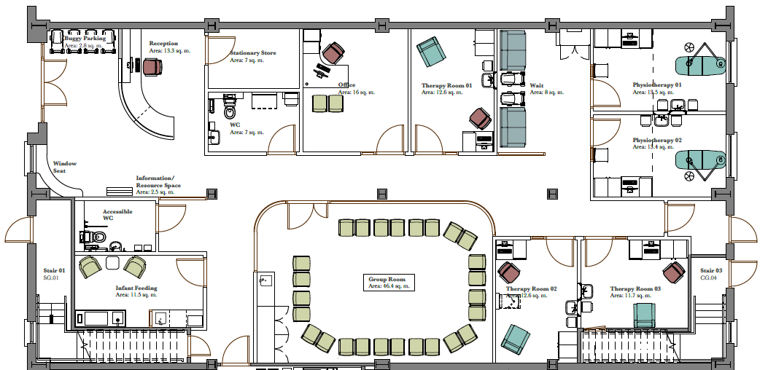
Women’s & Infants Health Hub CUMH
Formerly known as Postnatal Hubs
Potential Development
Space identified in South Ring Retail Park, Kinsale Road for development of CUMH Women’s & Infants Health HUB
CUMH services already there (Early Pregnancy Services and Physiotherapy with adequate staff quarters in place).
The facility would complete the space as an entire unit (see Image)
Architect engaged
Potential Site
CUMH Existing SITE

Slide 6
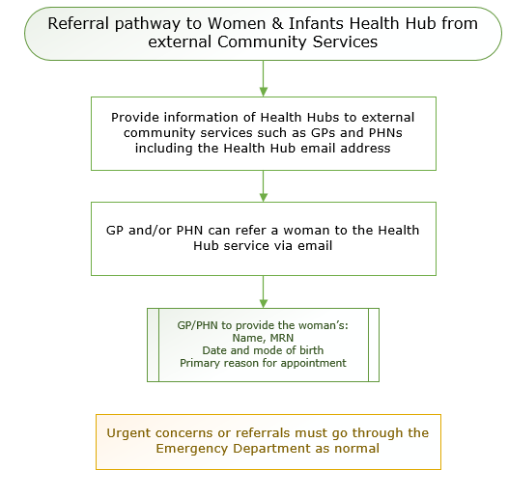
Pathway to Women’s & Infants Health Hub CUMH
Main Visit service provision:
Feeding concerns
General Support
Debriefing Clinic
Women’s Specialist Physio
Timing of Appointments:
Between 10 and 20 days (Challenges)

Slide 7
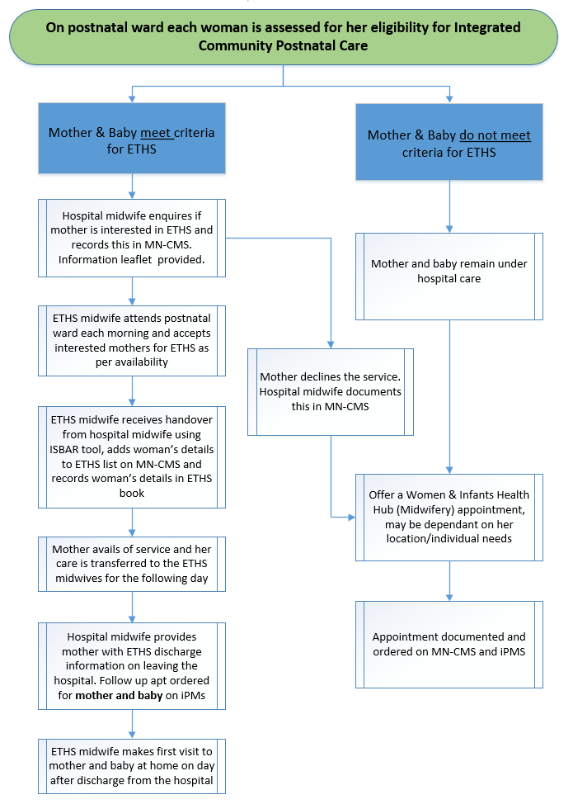
CUMH-Early Transfer Home Service (ETHS)
Team of 3 Midwives.
Recruit from PN Wards.
Visits- Approx 3 visits in the first week of life, midwifery support.
PHN still do bloodspot D4 (Mon-Fri)
ETH may be able to do Bloodspot @weekend.
Criteria for ETHS
Live within -15Km radius from CUMH
Medically low risk Mum/Baby.
GDMs, PROMs, C/S at 48-72hours.
Subject to availability (limited staff).

Slide 8
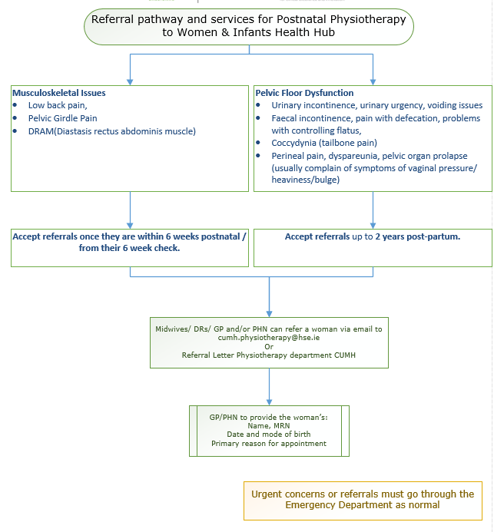

CUMH-Postnatal Physiotherapy Service
On the website we have pre-recorded postnatal physiotherapy education class which has very useful information for women who have given birth.
It covers all they need to know for the first 6 weeks- including
Caesarean Section advice,
Gentle tummy exercises,
Bladder & bowel care,
Perineal care,
PFM exercises,
How to return to fitness,
DRAM.

Slide 9

The Birth Reflections Service
Gillian Walsh, Staff Midwife
Alex Campbell, Registered Advanced Midwife Practitioner
28th February 2024

Slide 10

The Birth Reflections Service
Perinatal events may affect women in different ways. The research and evidence advocates supporting the emotional wellbeing of the mother, and this may have a positive impact on neonatal mental health in the longer term.
The National Maternity Experience Survey (2020) reported that 30% of women did not have a chance to discuss their birth.
Women can have an individual and subjective reaction to a birth experience. Healthcare professionals may not identify or recognise their experience as being a cause of confusion or upset.
We support mothers to feel heard and respected in a friendly
  environment where they can reflect on any aspect
  of their perinatal experience.
Birth partner is welcome to come and reflect as well

Slide 11
Birth Reflections Service: Inclusion/Exclusion Criteria
Inclusion Criteria
Must have given birth in CUMH or be planning to give birth in CUMH (this pregnancy)
- Includes women availing of homebirth
Recommend attending the service within 2 – 3 years of giving birth
Considerations/Exclusion Criteria
Less than 6 weeks postnatal not recommended for Birth Reflections Service
Acute mental health concern requiring specialised input; referral to SPMHS
The Birth Reflections Service and Specialist Perinatal Mental Health Service (SPMHS) work in collaboration with the women with two directional referrals in some cases
Language barrier – translation services to be used if it is deemed safe and
appropriate to proceed
Notes:
Inclusion Criteria: Mention regarding 2-3 years and why we chose that timeframe- Include women that may have come through service with COVID
Plan to reduce to 2yrs going forward

Slide 12
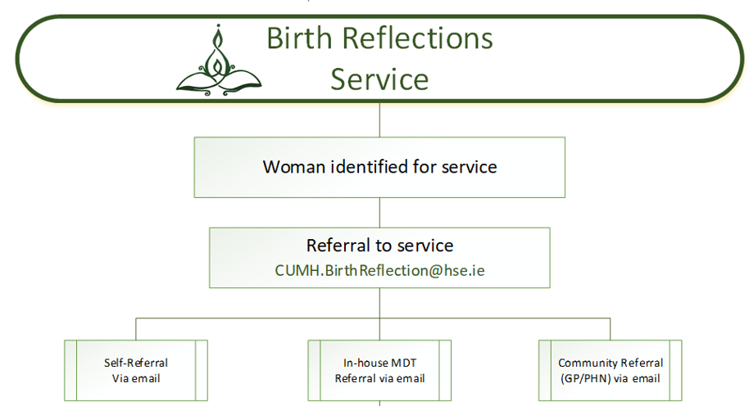
The Birth Reflections Service: Referrals
CUMH.BirthReflection@hse.ie
Ideally- self refer

Slide 13
The Birth Reflections Service: Triage of Referrals
Referral is sent in via email
A bounce back email automatically responds requesting further details
This allows for the service to review the information and chart to ensure that the referral is appropriate for the Birth Reflections Service
Allows a chart review prior to meeting the woman
Currently aim to make appointment within 1 – 2 weeks with the woman (Phone call with Birth Reflections midwife – call can last up to 30mins)
In person appointment (1hr appointment)
Notes:
Explain the phonecall and the richness of information shared by the women and the beginning of the relationship

Slide 14
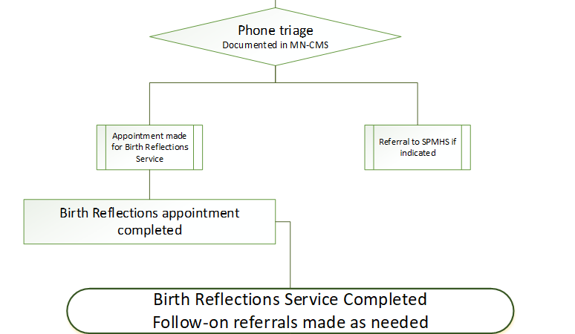
The Birth Reflections Service: Referrals

Slide 15
The Birth Reflections Service
This is a modern interpretation of the traditional Celtic Motherhood Knot symbolising the everlasting bond and connection between mother and child.

Slide 16
References
Fenech G and Thomson G (2014) Tormented by ghosts from their past’: A meta-synthesis to explore the psychosocial implications of a traumatic birth on maternal well-being. Midwifery, 30(2), pp.185–193. doi:https://doi.org/10.1016/j.midw.2013.12.004
Erickson N, Julian M, Muzik M (2019) Perinatal depression, PTSD, and trauma: Impact on mother–infant attachment and interventions to mitigate the transmission of risk. International Review of Psychiatry, 31(3), p. 245-263, DOI: 10.1080/09540261.2018.1563529
Higgins A, Carroll M, Gill A, Downes C, Monahan M (2021). Perinatal Mental Health Care: Best Practice Principles for Midwives, Public Health Nurses, and Practice Nurses [Updated]. Dublin: Health Service Executive
Responding to the Results of the National Maternity Experience Survey (2020) Dublin: Health Service Executive. Available at: https://www.hse.ie/eng/services/publications/hse-response-to-the-findings-of-the-national-maternity-experience-survey-2020.pdf
National Maternity Experience Survey 2020 (NMES 2020) Dublin: Health Service Executive. Available at: https://yourexperience.ie/wp-content/uploads/2020/09/National-Maternity-Experience-Survey-results.pdf
Baxter J (2019) Postnatal debriefing: women’s need to talk after birth. British Journal of Midwifery, 27(9), pp.563–571, doi: https://doi.org/10.12968/bjom.2019.27.9.563

Slide 17




Slide 18
Regional Fertility Hub CUMH
Ms Eilis McCarthy, CMM 3 Fertility Services, CUMH
Dr Moya McMenamin, Consultant O&G, CUMH

Slide 19


Infertility
Infertility is defined as a disease characterised by failure to conceive a pregnancy within 12 months of regular unprotected sexual intercourse or due to the inability to reproduce, either as an individual or with a partner (WHO 2020) (ESHRE 2020)
Prevalence – 1 : 6 couples
Notes:
Upwards of 20,000 couples in SSWHG affected by infertility

Slide 20
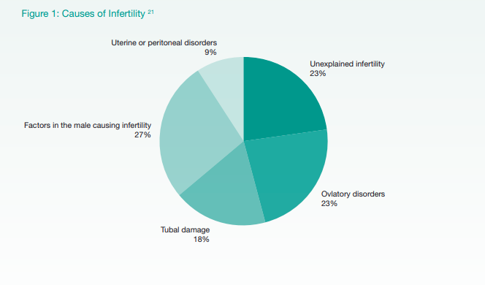
Causes of Infertility
Male Factors
Pre-testicular
Extra-testicular
Testicular
Post-testicular
Female factors
Ovulation Disorders
  Hypothalamic Pituitary Failure
  Hypothalamic-Pituitary-Ovarian Dysfunction
  Ovarian Failure
Tubal Factors
Uterine or Peritoneal Factors

Slide 21
Factors associated with Infertility
Maternal and paternal Age
Tobacco Use
Alcohol
Illicit Drug Use
Body Mass Index (BMI) < 18.5 or > 25/Kg/m2

Slide 22
Initial Advice
Female age
Frequency and timing of intercourse
Diet and supplementation
Body Mass Index
Exercise
Smoking / Vaping
Caffeine
Mental health

Slide 23
When to Refer
Fertility investigations and referral to secondary or tertiary care should be offered to couples of reproductive age who have been trying to conceive for 12 months with no known underlying medical condition
Earlier referral should be considered if the female is 36 years of age or older, or there are underlying medical conditions that may affect reproduction in either intending parent
NB – female BMI 18.5 - 35
NB – female age 18 - 42+364 days, male age 59 and under

Slide 24
On Receipt of the GP Referral
Regional Hub Information Pack posted to patient
Both partners complete a referral questionnaire
On receipt of the completed questionnaires the fertility nursing team will arrange appointments for
  AMH
  Pelvic Ultrasound
  Female Hormone Profile (if not already completed)
  Rubella +/ VZIG Immunity (if no history of prior infection or vaccination)
  Urine for Chlamydia and Gonorrhoea
  Semen Analysis
Appointments will be then be sent for a Medical Consultation

Slide 25
Medical Consultation
Further targeted fertility investigations and diagnostic procedures for both partners as needed
  Tubal patency test (HSG or hysteroscopy/laparoscopy & dye)
  Polypectomy
  Myomectomy
  Surgical management of tubal disease/endometriosis
  Genetic tests
  Scrotal US
Further specialist referral if needed
  Pre-conception counselling
  Urology
  Genetics
  Endometriosis Centre
  Other specialists as required

Slide 26
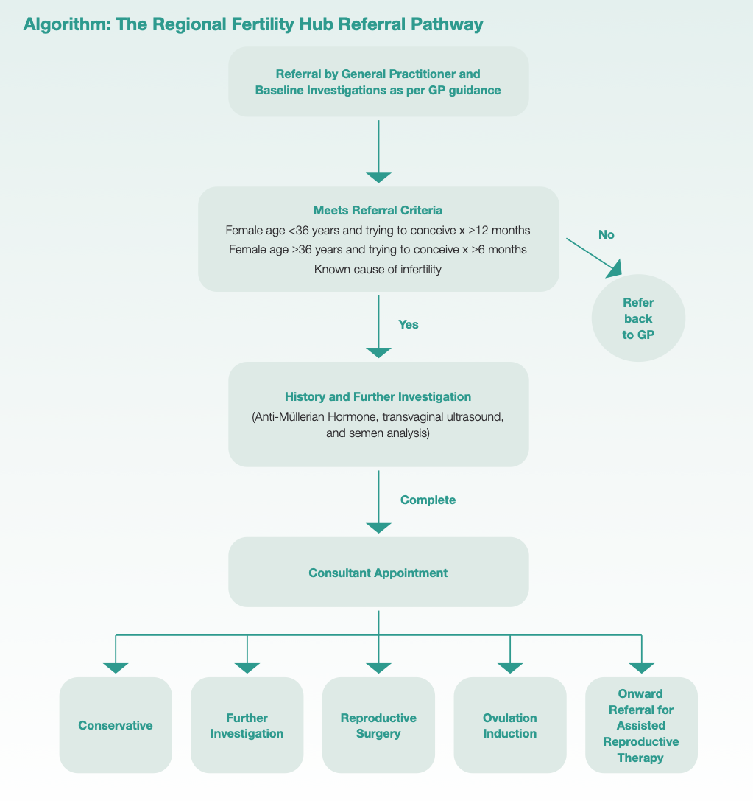

Slide 27

Regional Fertility Hub CUMH
Based in The Lee Clinic, Lee Road
3 consultants/3 x weekly fertility clinics
  Dr Moya McMenamin
  Dr Minna Geisler
  Dr Manal Younis
Fertility nurse specialists:
CNM 2 x 0.5 WTE x 2
Staff Nurse – WTE x 2.4
CMM 3 / cANP fertility – 1 x WTE
2 WTE administration staff
Ovulation induction service

Slide 28
Referrals to Regional Fertility Hub
Total referrals 2022 – 299
Total referrals 2023 - 710

Slide 29
UAN Referrals to Private Provider for ART
52 Patients referred to date for ART
ICSI X 20
IVF X 17
IUI X 15
Eligibility Criteria for AHR Treatments
Residency
18-40yrs female/59 or under male
No living children together
In relationship >1yr
No history sterilization
No more than 1 previous IVF cycle
BMI 18.5-30 female
Non-smoker
No drugs

Slide 30
Waiting Times
Ultrasound
Consultation
Referral to ART provider

Slide 31
Future Developments
In-house HyCoSy service development
In-house semen analysis and intrauterine insemination service
Development of 1st public IVF unit in Ireland

Slide 33

CUMH – Updates Early Pregnancy Unit &
Early Termination of Pregnancy
Dr Deirdre Hayes-Ryan
Clinical Lead Early Pregnancy & Termination of Pregnancy CUMH

Slide 34
Updates Early Pregnancy CUMH
Offsite EPU Clinic September 23
CUMH.EPUnit@hse.ie
021 4927441
CUMH Kinsale Road Clinic, Unit 3, 3A and 4A South Ring Business Park, Kinsale Road, Cork T12F88X

Slide 35
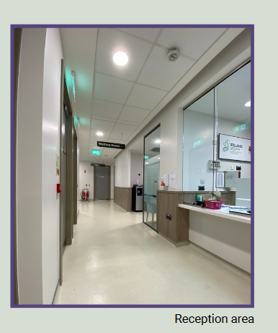
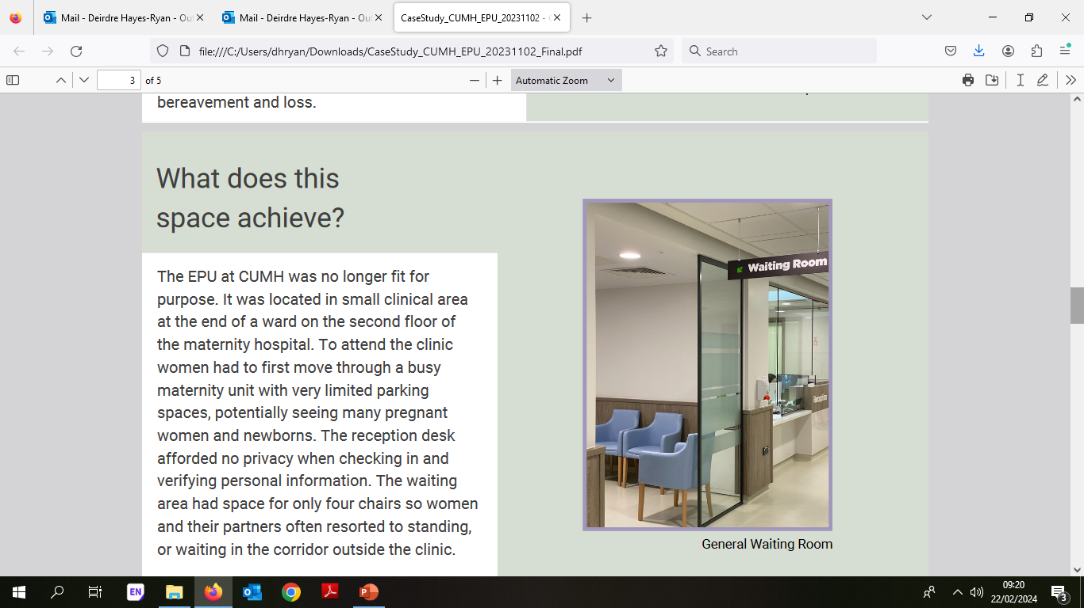
Kinsale Road Offsite EPU
Notes:
The EPU at Cork University Maternity Hospital (CUMH) reviews over 5,000 women annually while operating Monday-Friday from 08:00 to 13:00. It was recognised from patient feedback that the early pregnancy service had outgrown its previous location and that its position within CUMH was no longer suitable for patient or staff requirements. In September 2023, the EPU at CUMH relocated offsite to a new premises 4km from the maternity hospital. In doing so, it became the first EPU in Ireland to operate offsite from a maternity unit.

Slide 36
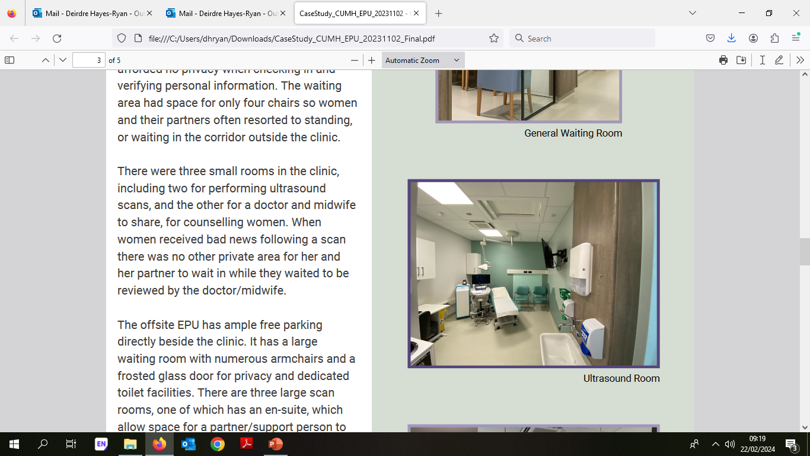
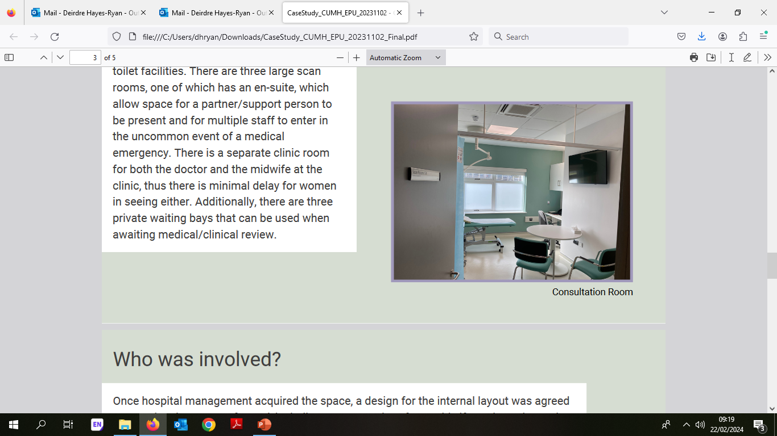
Kinsale Road Offsite EPU
Notes:
The offsite EPU has ample free parking directly beside the clinic. It has a large waiting room with numerous armchairs and a frosted glass door for privacy and dedicated
toilet facilities. There are three large scan rooms, one of which has an en-suite, which allow space for a partner/support person to be present and for multiple staff to enter in the uncommon event of a medical emergency. There is a separate clinic room for both the doctor and the midwife at the clinic, thus there is minimal delay for women
in seeing either.

Slide 37
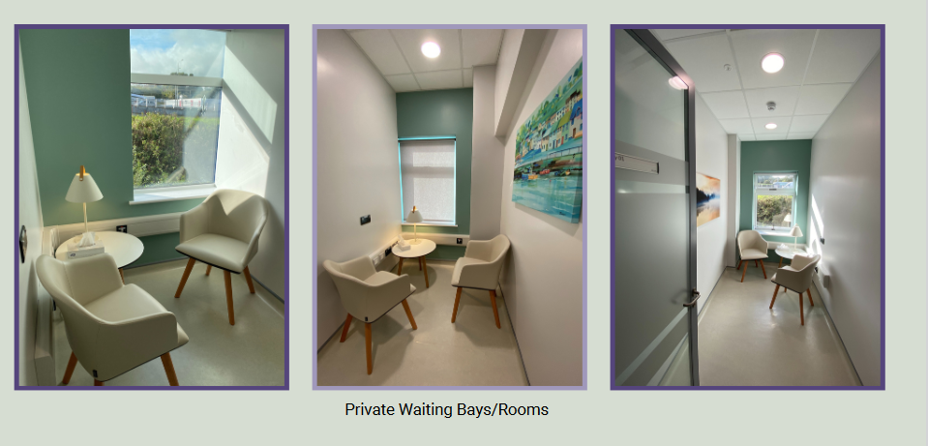
Kinsale Road Offsite EPU
Notes:
Additionally, there are three private waiting bays that can be used when awaiting medical/clinical review. In line with the National Maternity Strategy, Bereavement Standards and future planning and development of the services, there are numerous advantages of the community offsite location. These include: potential for early pregnancy services to run all day rather than just in the mornings appropriate duration for each ultrasound appointment dedicated unit specific clinical staff including a dedicated early pregnancy registrar and consultant lead ensuring consistency of service provision.

Slide 38
Referral criteria EPU;
Positive pregnancy test & <13 week’s gestation with;
Vaginal bleeding or non-severe abdominal pain in current pregnancy -next available
History indicated;
  A previous history of ectopic pregnancy - 6 weeks’ gestation advised
  A previous history of molar pregnancy -8 weeks’ gestation advised
  A previous history of miscarriages - 8 weeks’ gestation advised
  A pre-existing medical condition known to increase the risk of miscarriage eg; Insulin dependent diabetes mellitus - 8 weeks’ gestation advised
Notes:
NB; Systolic Blood Pressure <100mmHg, Pulse Rate >90, Size of clot >3cm (golf ball size), Fully soaked pad >1 in one hour

Slide 39
Referral to the Emergency Room CUMH
Women who are bleeding heavily or are haemodynamically unstable
Women with severe pain
Hyperemesis
All non-pregnant urgent gynaecology referrals
Women who are acutely unwell or haemodynamically unstable will be directed to the CUMH Emergency Department
Notes:
It is important women are haemodynamically stable at the time of referral. If there are any changes in a woman’s symptoms after the referral has been accepted please phone the EPC directly 021-4927441 or the CUMH emergency room for advice +/-assessment.
NB; Systolic Blood Pressure <100mmHg, Pulse Rate >90, Size of clot >3cm (golf ball size), Fully soaked pad >1 in one hour

Slide 40
If patient is well and does not need immediate medical attention or admission
Give patient contact details (Tel 021 4927441) for self-referral if history indicated
  instruct patient to call clinic 08:00-10:00am the next morning to speak with triage team
Other referrals from the GP/healthcare provider, email or healthlink
Notes:
If seeing a patient outside of Community Early Pregnancy Clinic hours, instruct patient to call clinic 08:00-10:00am the next morning to speak with a triage team member who will arrange an appointment. This appointment may not always be the same day. For patients needing referral on a Saturday or a Sunday, advise patient to call on Monday morning from 08:00-10:00am.

Slide 41
Transfers from EPU to CUMH
28th Aug 23 – 31st Dec 23
1779 ultrasound appointments
18 transfers;
  3 ambulance –direct to ED
  15 self –direct to 2 South unless otherwise directed
1%
transfer rate
Notes:
Monday - Friday 08:00 -13:00, ~23 scans daily by appointment only
Staff; Registrar, Midwife, Admin Officer, Sonographer x 2
Transfer to CUMH;
Ectopic (surgical or medical mgt)
Further assessment required
Haemodynamically unstable

Slide 42
Points to highlight
Indication and LMP on referral
No scan for dates; If uncertainty re dates and normal pregnancy (no previous hx of misc) we arrange for dating scan 8 weeks from first positive pregnancy test. (99% of them are correct)
If attending fertility clinics have 6 & 8 week viability scans, no need referral to EPU as well
If the patient has had a positive pregnancy test, then a heavy PV bleed and bleeding is minimal and negative pregnancy test, GP can confirm miscarriage
Progesterone & Aspirin

Slide 43
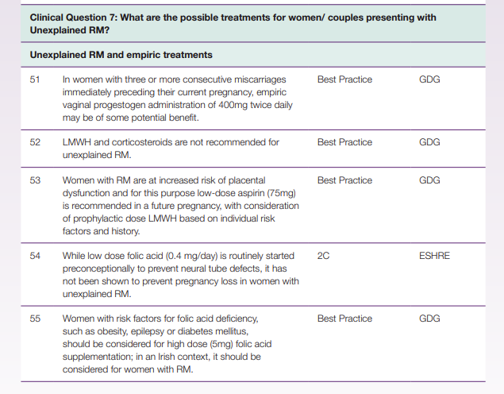
Points to highlight

Slide 44
Updates; Early Termination of Pregnancy
Surgical early TOP Service; MVA & STOP

Slide 45

Pathway for Section 12 Early TOP care CUMH
GP Provider contacts TOP Co-Ordinator at CUMH and forwards certification form
TOP Co-Ordinator arranges appointment for the woman in the Pregnancy Options Clinic Tuesday pm with ultrasound prior in the early pregnancy unit +/- Social Worker review if required
Woman elects to proceed with Medical TOP (MTOP)
Mifepristone in clinic
Bloods: FBC and G&H
Bed booked on gynae ward and contact info given
Woman elects to proceed with Surgical TOP (STOP)
Manual Vacumn Aspiration (MVA)
Admitted to OPH unit Wednesday am at pre- specified time. No fasting required
STOP in Theatre
Admitted to ward 2 South fasting Friday am at 06:30
Admitted to ward 2South Thursday 6AM
Misoprostol regimen until complete MTOP confirmed
Contraception provided PRN

Slide 46
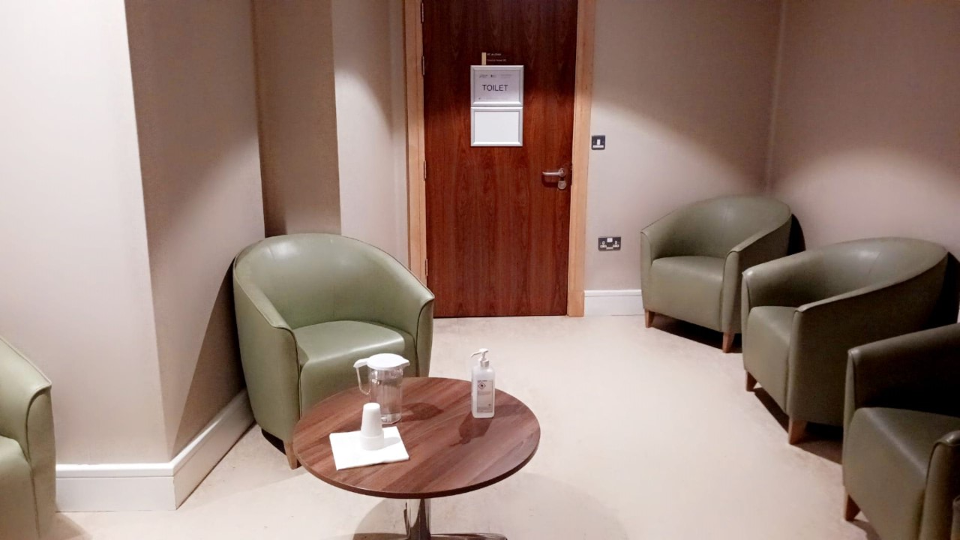
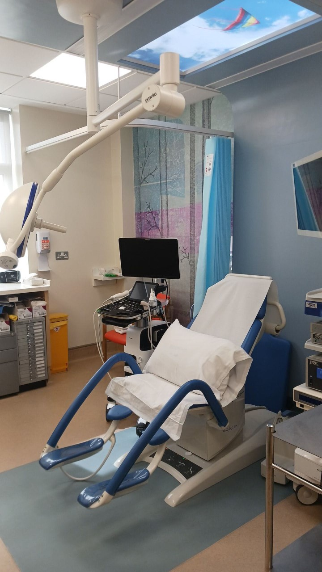
Manual Vacuum Aspiration CUMH
Notes:
The MVA procedure is performed in a clinical room in the outpatient setting, in Cork University Maternity Hospital (CUMH).
The patient’s level of comfort can be improved by different factors, such as; a procedure room that is quiet and comfortable and a clear explanation of what to expect before, during and after the procedure.
Staffed by Consultant, Midwife & HCA; Healthcare professionals who are calm, friendly, empathetic, unhurried and efficient can also make a considerable difference.
Each patient is given a 45 minute time slot. The procedure itself takes <3 minutes on average hence amply time is available for recovery afterwards.
Patients are provided with Tea/Coffee, given Anti-D if Rh negative and further oral analgesia if required.

Slide 47
Patient Selection for Manual Vacuum Aspiration:
Suitable | Not Suitable
haemodynamically stable | cervical stenosis
well-motivated women who can tolerate speculum examination | fibroid uterus >12 weeks in size
no clinical signs of infection (fever, offensive discharge or generalised lower abdominal pain) | contraindication to the use of misoprostol or to local anaesthetic agents haemorrhagic disorder and treatment with anticoagulants uterine malformation
No evidence of bone ossification on scan | Panic attacks

Slide 48
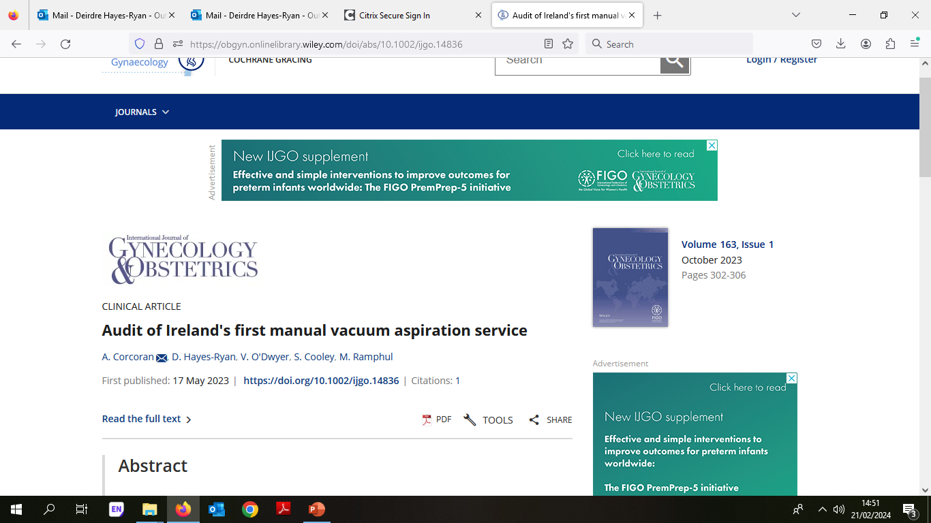
Manual Vacuum Aspiration; Irish Perspective
86 women over 18 months
98.8% successfully completed
Nil procedural complications
Incomplete evacuation rate 4.7%
Notes:
Safe & Effective
Well tolerated
18 months of service; 86 women underwent MVA, 85 (98.8%) of which were successfully completed. There were no immediate procedural complications, inter-hospital transfers, or emergency electric vacuum aspiration (EVA) required. We obtained an incomplete evacuation rate of 4.7% (n = 4).

Slide 49
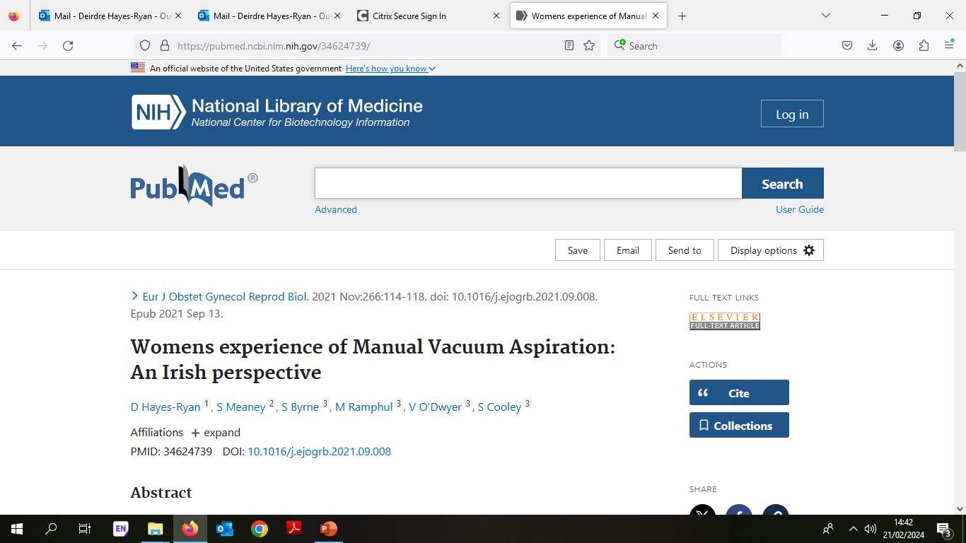
Manual Vacuum Aspiration; Womens Perspective
Qualitative Research project –feedback survey 2 weeks post MVA procedure
“I had expected it to be very painful but I actually didn’t feel anything during it or even at home afterwards”
“Because it wasn’t a big operating theatre I wasn’t scared, it was comfortable, like a Drs office”
“it is pretty painful but it is very quick”
“the contact numbers were clearly highlighted, and it was very well explained what to do if I had any problems”
“it was uncomfortable during it but afterwards I had no pain at all”
Notes:
Thus far we have demonstrate that our new MVA service is effective, safe and has a positive financial impact on our hospital.
In order to evaluate the acceptability of MVA among women, we are conducting a Qualitative Research project with consenting participants
The study is on-going at present but preliminary results show that;
Women living in Ireland are generally interested and agreeable with having MVA as an available option
Appropriate pre procedure counselling and provision of adequate information is paramount in aiding women to make an informed decision in choosing MVA
The potential of a quick and effective treatment generally compensates for the discomfort experienced during the procedure.
We look forward to sharing the full results of this paper in the near future.

Slide 51
Apixaban for extended postoperative VTE prophylaxis in gynaecologic oncology patients undergoing laparotomy at CUMH
Dr. Zibi Marchocki
Consultant Gynaecologic Oncologist
CUMH
Notes:
Apixaban for extended postoperative thromboprophylaxis in gynecologic oncology patients undergoing laparotomy

Slide 52
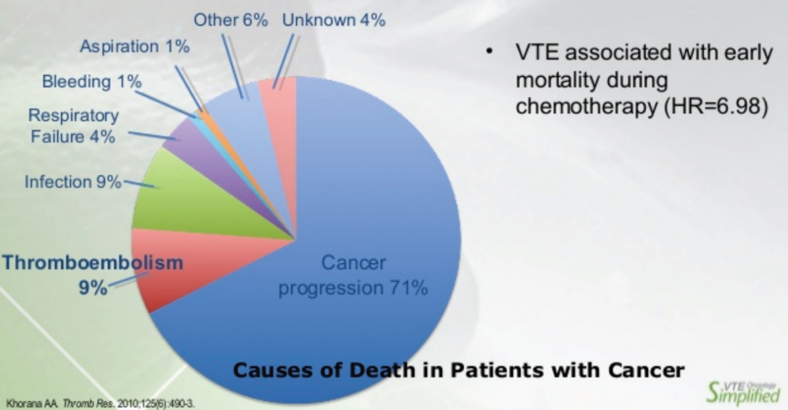
VTE in Cancer Population
VTE is a leading cause of death in cancer patients after the cancer itself
It is the most common cause of death in cancer patients in the first 30 days post cancer surgery
Khorana AA. Venous thromboembolism and prognosis in cancer. Thromb Res. 2010;125(6):490-493. doi:10.1016/j.thromres.2009.12.023

Slide 53
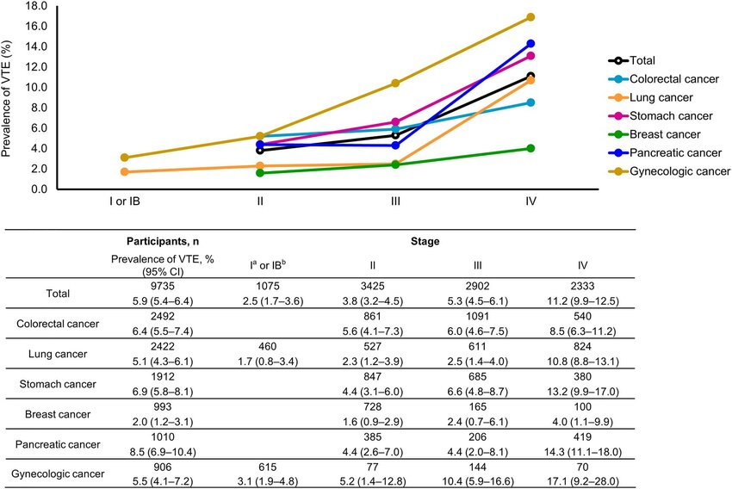
VTE in Cancer Population
Ohashi Y, Ikeda M, Kunitoh H, et al. Venous thromboembolism in cancer patients: report of baseline data from the multicentre, prospective Cancer-VTE Registry [published correction appears in Jpn J Clin Oncol. 2020 Oct 22;50(11):1346]. Jpn J Clin Oncol. 2020;50(11):1246-1253. doi:10.1093/jjco/hyaa112

Slide 54
VTE in Gynaecologic Cancer
4-9% - cervical cancer
4-9% - endometrial cancer
17-38% - ovarian cancer
3% of new ovarian cancer diagnosis will have a concomitant VTE diagnosed before they start cancer treatment
Cohen A, Lim CS, Davies AH. Venous Thromboembolism in Gynecological Malignancy. Int J Gynecol Cancer. 2017;27(9):1970-1978. doi:10.1097/IGC.0000000000001111

Slide 55
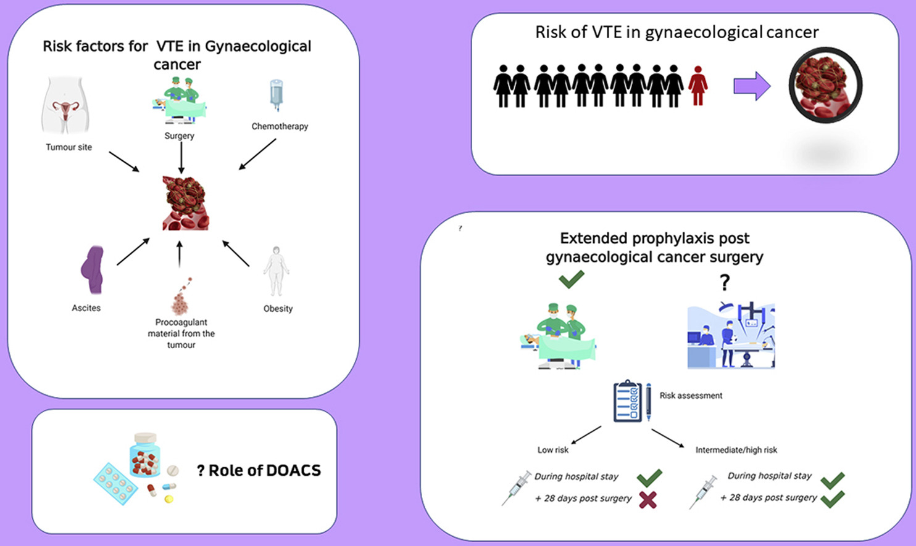
VTE in Gynaecologic Cancer
The risk of VTE is doubled compared with patients undergoing non-cancer surgery
Ibrahim E, Norris LA, Abu Saadeh F. Update on extended prophylaxis for venous thromboembolism following surgery for
gynaecological cancers. Thrombosis Update 2021;2.

Slide 56
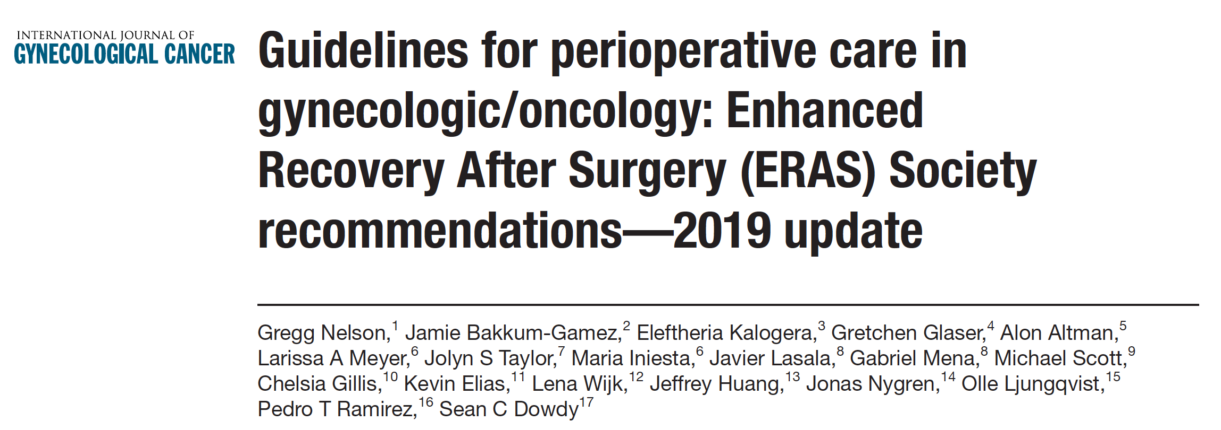
Postoperative VTE prophylaxis
“All gynecologic oncology patients who undergo major surgery lasting longer than 30 min should receive dual VTE mechanical prophylaxis and chemoprophylaxis”
“Prophylaxis should be initiated pre-operatively and continued post-operatively. Extended chemoprophylaxis (28 days post-op) should be prescribed to patients who meet high-risk ACCP criteria, including patients with advanced ovarian cancer.”

Slide 57
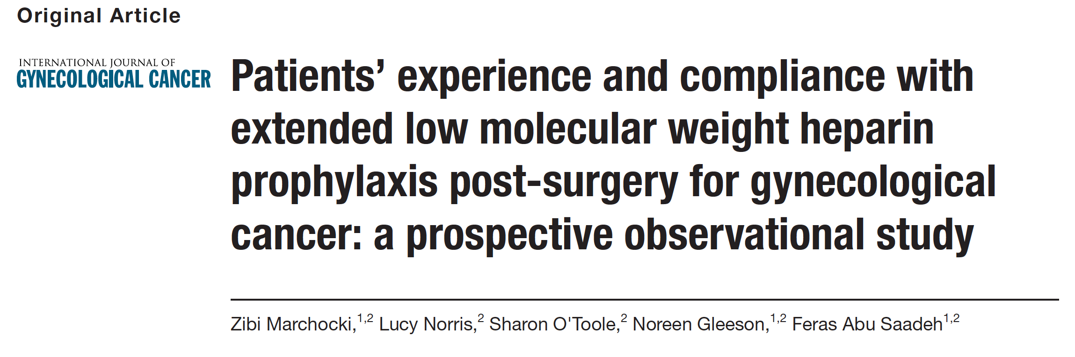
LMWH vs. DOAC
62% - compliance with standard recommended LMWH regimen of 28-days prophylaxis
86% - preference for a tablet form, if one was available
Marchocki Z, Norris L, O'Toole S, Gleeson N, Saadeh FA. Patients' experience and compliance with extended low molecular weight heparin prophylaxis post-surgery for gynecological cancer: a prospective observational study. Int J Gynecol Cancer. Published online April 16, 2019. doi:10.1136/ijgc-2019-000284

Slide 58
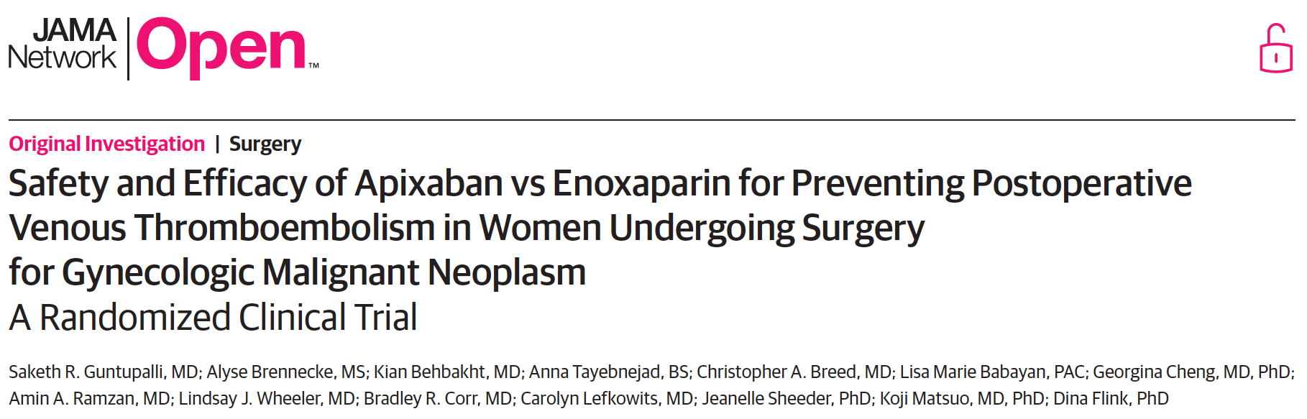
DOAC - Apixaban
400 randomized: 204 received apixaban and 196 received enoxaparin.
No statistically significant differences between the apixaban and enoxaparin groups in terms of:
  rates of major bleeding events (1 patient [0.5%] vs 1 patient [0.5%]; odds ratio [OR], 1.04; 95%CI, 0.07-16.76; P > .99),
  clinically relevant nonmajor bleeding events (12 patients [5.4%] vs 19 patients [9.7%]; OR, 1.88; 95%CI, 0.87-4.1; P = .11),
  VTE events (2 patients [1.0%] vs 3 patients [1.5%]; OR, 1.57; 95%CI, 0.26-9.50; P = .68),
  adverse events, medication adherence, or quality of life between the groups.
Participant satisfaction was significantly greater in the apixaban group with regard to ease of taking the medication, and pain associated with taking the medication.

Slide 59
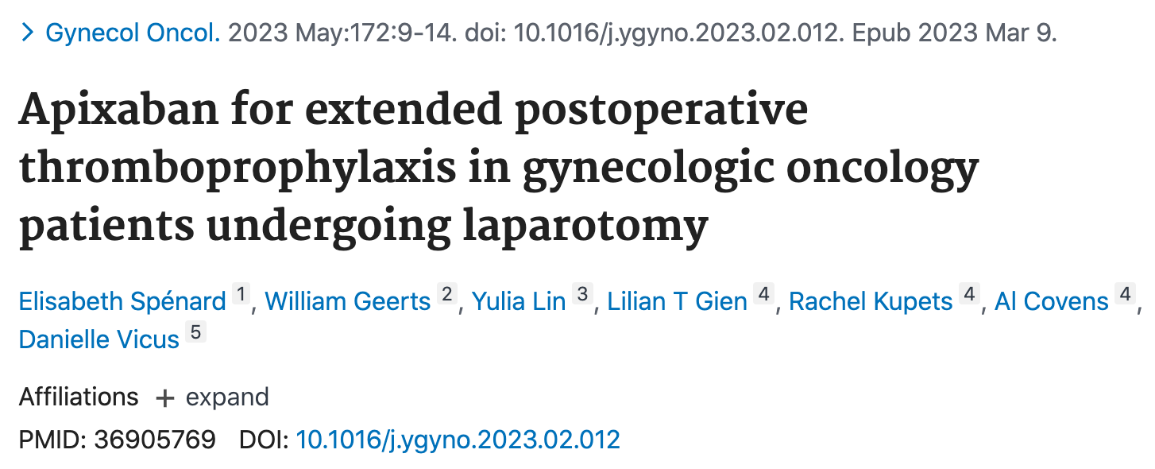
DOAC - Apixaban
No difference was found between total VTE rates (4% vs. 3%, p = 0.49).
No difference was found in postoperative readmission (5% vs. 6%, p = 0.50).
No patient required a reoperation for bleeding.

Slide 60
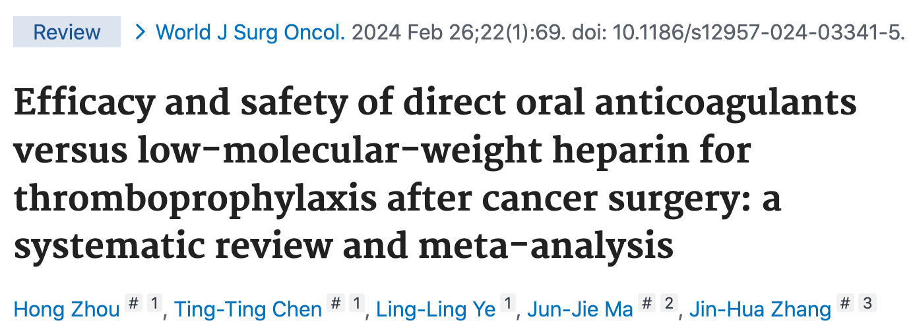
DOAC vs. LMWH
Compared to LMWH thromboprophylaxis, DOACs had a comparable risk of:
  VTE (RR:0.69[95% CI:0.46-1.02], I² = 0%),
  Major bleeding (RR:1.55 [95% CI:0.82-2.93], I² = 2%), and
  CRNMB (RR, 0.89 [95% CI, 0.4-1.98], I² = 31%) during the 30-day postoperative period.

Slide 61
September 2023
Apixaban 2.5mg, BID, 28 days in total

Slide 63
Apixaban postoperative VTE prophylaxis for Gynaecologic Oncology patients at CUMH
September 2023
29 patients discharged home on apixaban prophylaxis so far
2 readmissions with hematoma, no VTE
Post apixaban survey – high adherence and satisfaction rate

Slide 65
Complex Menopause
Dr. Brenda Moran, Dr. Karen Soffe, CNM 2 Rachel Guerin

Slide 66

Background
Women’s Health Taskforce est. 2019
↓
Recognition that better access to menopause care and supports were required
↓
Women’s Health Action Plan 2022-2023
  Action 4B: Changing the approach to menopause care to ↑ public supports to women before, during & after menopause
↓
Ring fenced money for Specialist Menopause Clinics
↓
Funded by NWIHP
Notes:
. The Taskforce includes staff from within the department as well as external partners including the European Institute for Women’s Health, the HSE including the National Women and Infants’ Health Programme, The National Women's Council of Ireland, The Irish College of General Practitioners, The Institute of Public Health, and the Department of Children, Equality, Disability, Integration and Youth.
The Taskforce has listened to, engaged with and worked with more than 2,000 individuals and organisations representing women across the country.
The Taskforce has modelled “open policy making” working in a collaborative way, involving policy makers, clinicians, international partners, advocates, health experts and the voices of women through workshops, research and outreach.
The Dr. Gabriel Scally
Scoping Inquiry into the CervicalCheck Screening Programme
recommended
that the health sector needed more committed, consistent attention to women’s health issues.
This 18-month Women’s Health Action Plan is one key element in maintaining momentum
towards this goal.

Slide 67

Complex Menopause Clinic
Located in the Lee clinic, Lee Road, 1st Floor (Suite 11, Block 2)
GP led service (BMS Accred. menopause specialists)– 6 hrs/wk.
2 x GP 0.1 WTE
WTE CNM2
0.5 WTE Admin ( Oli Oliver)
Email: CUMH.ComplexMeno@hse.ie
Tel: 021-4234240

Slide 68
Eligibility Criteria for the Complex Clinics
Established ischaemic heart disease, structural heart disease, & arrythmias
Stroke & TIA
VTE, arterial thrombosis, & thrombophilia
Breast & sex hormone receptor sensitive cancer
Active liver disease
Immunological diseases
Premature Ovarian Insufficiency (menopause under the age of 40 years)
*******This is not an exhaustive list

Slide 69
Referral Pathway
Referral forms have been circulated via email - we hope to have these on the CUMH website shortly
Healthlink
Letter
All referrals are sent to Central Appointments first, and then to Complex Menopause to be triaged
SSWHG catchment area only
Notes:
There was an email circulated to staff and some GP practices that should have details of referrals and how to but this is the pathway . All referrals need to be accounted for via central appointments. We do get some direct to the clinic which can affect waiting times as we have to send on to central appointments.

Slide 70
Additional Information Requests
We know that this is an additional bureaucratic layer for GPs, but
  Access to relevant Speciality letters stating the medical condition, treatment, investigations, histology, is required - as it impacts considerably on decision making – otherwise decisions are deferred & additional appointments required
  This info can be sent with the initial referral letter & posted/ emailed to central appointments (CUMH.CAppointments@hse.ie) – ideal route ; or posted or emailed to Complex Menopause ( additional info only)
  Hopefully in time, this information can be sent via Healthlink as attachments

Slide 71
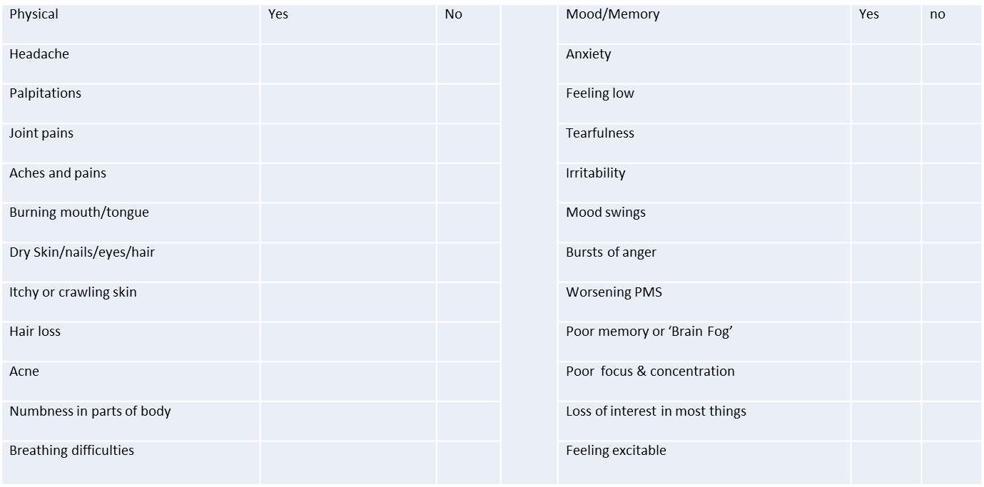
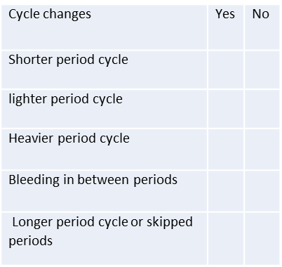
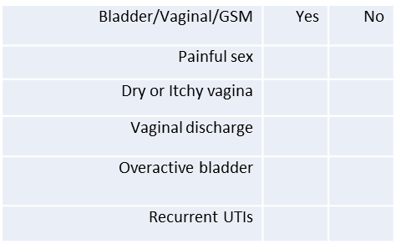
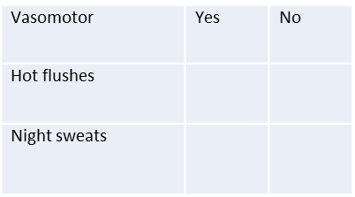
Pre-Clinic Questionnaire
Modified version of the Greene Climacteric Scale
“What is bothering you the most” – helps to focus the consult
We can then refer to this over subsequent consultations to assess response to treatment options.

Slide 72
The Consultation
We gather as much info as possible pre-consult; 45 mins to address the below
Symptoms
Cardiovascular risk factors
Bone Health risk factors
Breast Cancer risk factors
Periods
Contraception
GSM
Lifestyle & Screening
Education & Treatment options
ICGP Quick Reference Guide on Diagnosis & Management of Menopause in GP
IMS Recommendations on women’s midlife health and menopause hormone therapy. Climacteric. 2016 Apr;19(2):109-150.

Slide 73
Exercise
Healthy diet
Acupuncture
Pelvic physiotherapy
What could multimodal therapy look like for me?
Vaginal moisturiser +/- vaginal estrogen
CBT +/-
mindfulness +/- coaching +/-
Prescribed
non-hormonal therapy
Yoga +/- pilates

Slide 74

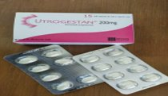
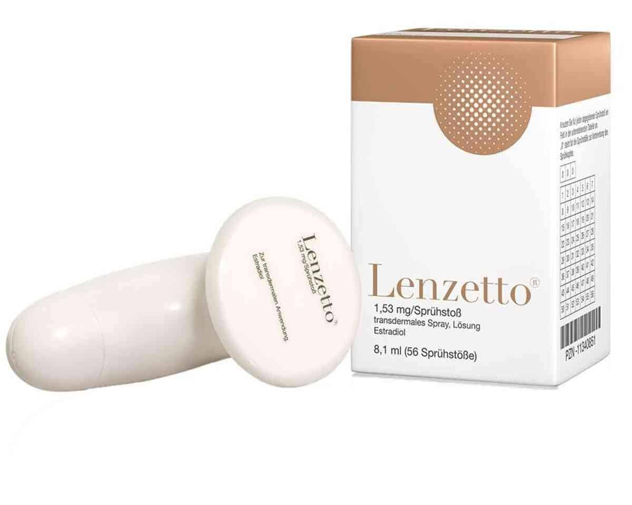

HRT
Tend to use low-standard dose transdermal oestrogen in those with medical comorbidities
“Low and slow”; individualised approach
“Body-identical oestradiol &“ micronised progesterone/ “body-similar” dydrogesterone. Appears to be clot neutral and assoc. with less cardiac, breast risk
“Body-identical” – similar in structure to our own ovarian hormones ( essentially labelling)
LNG-52mg IUD (MEC 2 following VTE; cardiac) (good option for HMB & perimenopause)

Slide 75
Tips for tricky cases that don’t meet the criteria
Where possible, we write a letter of advice which is either a template reply or individualised.
Often, we have no magic answers either…..

Slide 76
In vast majority of cases a patient’s own GP is best placed to manage their menopause but some can be tricky……….
Strong family Hx hormone dependant cancers
Lots of Cardiovascular risk factors
Personal history of non-hormone dependant cancers
Progestogen intolerance
Poor symptom control
Where to get help?

Slide 77
Strong Family History of Breast Cancer
Always trying to establish, what is the risk? IBIS score sometimes helpful
Do we need assistance to delineate this further? e.g family History clinic, BRCA testing.
What can we do to reduce the risk? Risk reducing surgery or extra screening, weight management.
What impact would HRT have on the risk? Are statistics reliable?
A women at “ normal risk” 23/1000 ? HRT adds 8-17%, woman with increased risk eg 100/1000 the additional 2-4 extra cancers that HRT provides is 2-4% of her risk
Will that matter if they end up being one of the 2-4?

Slide 78
Minimising the impact of HRT on the breast and maximise early detection
Self-examination + whatever screening is deemed necessary
? The progestogen type is key
It is DURATION and not DOSE dependent
Consider what benefits are they likely to get- not always clear….
What are the alternative options to HRT?
Ultimately once fully informed of the likely benefits v risks - then the decision is up to the patient.
Annual reviews
What about testosterone??

Slide 79
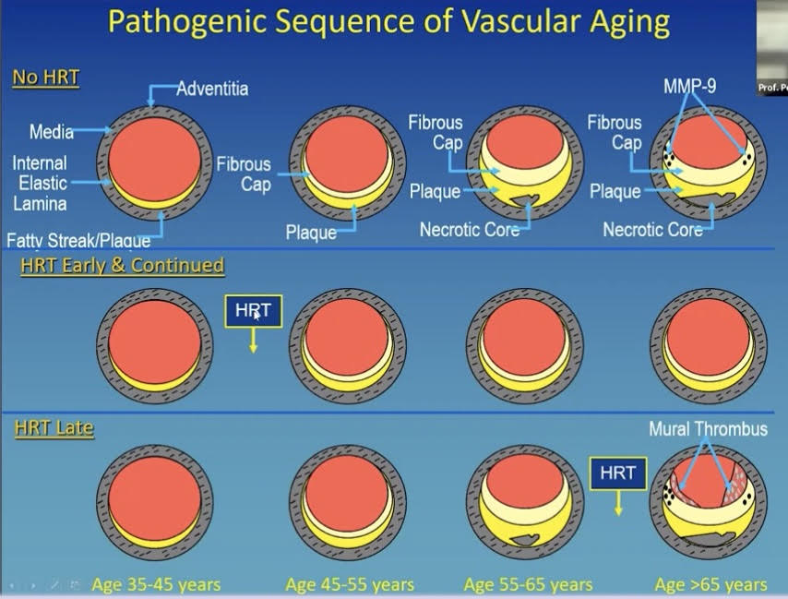
High Cardiovascular Risk
Confusion historically as COCP guidelines around BP/cholesterol/ diabetes etc
Real Q. is around where the patient is in the development of disease

Slide 80
High Cardiovascular Risk
Ultimately further investigations may be required to give you more information
HRT is not licenced for primary prevention of CV disease
Smoking cessation, tight BP control, treatment of hypercholesterolaemia and diabetes are all better at reducing risk
If starting – topical and low and slow

Slide 81
Non-Hormonal Dependent Cancers
“there are known knowns; there are things we know we know. We also know there are known unknowns; that is to say we know there are some things we do not know. But there are also unknown unknowns—the ones we don't know we don't know”
“Evidence of no harm” is not the same as “No evidence of harm”
The rarer the cancer, the less evidence we have
Special consideration for those plunged into an early menopause due to their cancer treatment

Slide 82
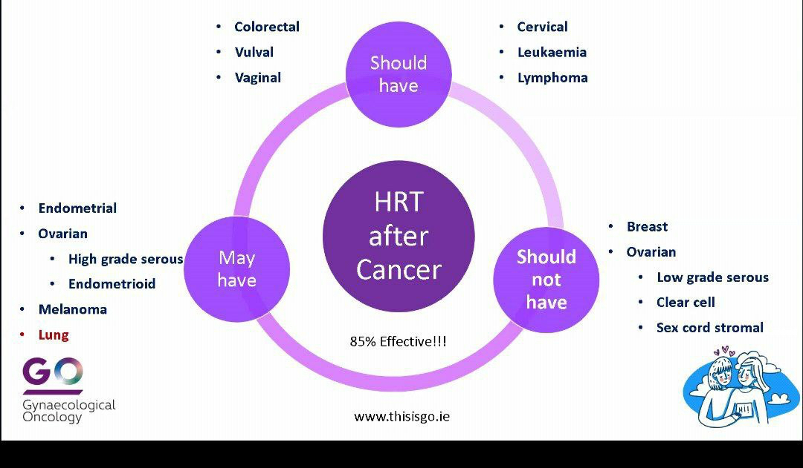
Thisisgo.ie

Slide 83
Resources to help you
Join the telegram “HRT prescribers” group
ICGP Quick Reference Guide
Evorel.ie Management guide
GP buddy
BMS Tools for Clinicians or Womens-health-concern.org
Drug interaction trackers e.g. on Drugs.com

Slide 85
Q&A

